Slide 1
EPA Assessor Training
BSc Digital & Technology Solutions Degree Apprenticeship
Integrated Degree Reference: ST0119
Version: 1.1
updated 28/9/2025

Slide 2
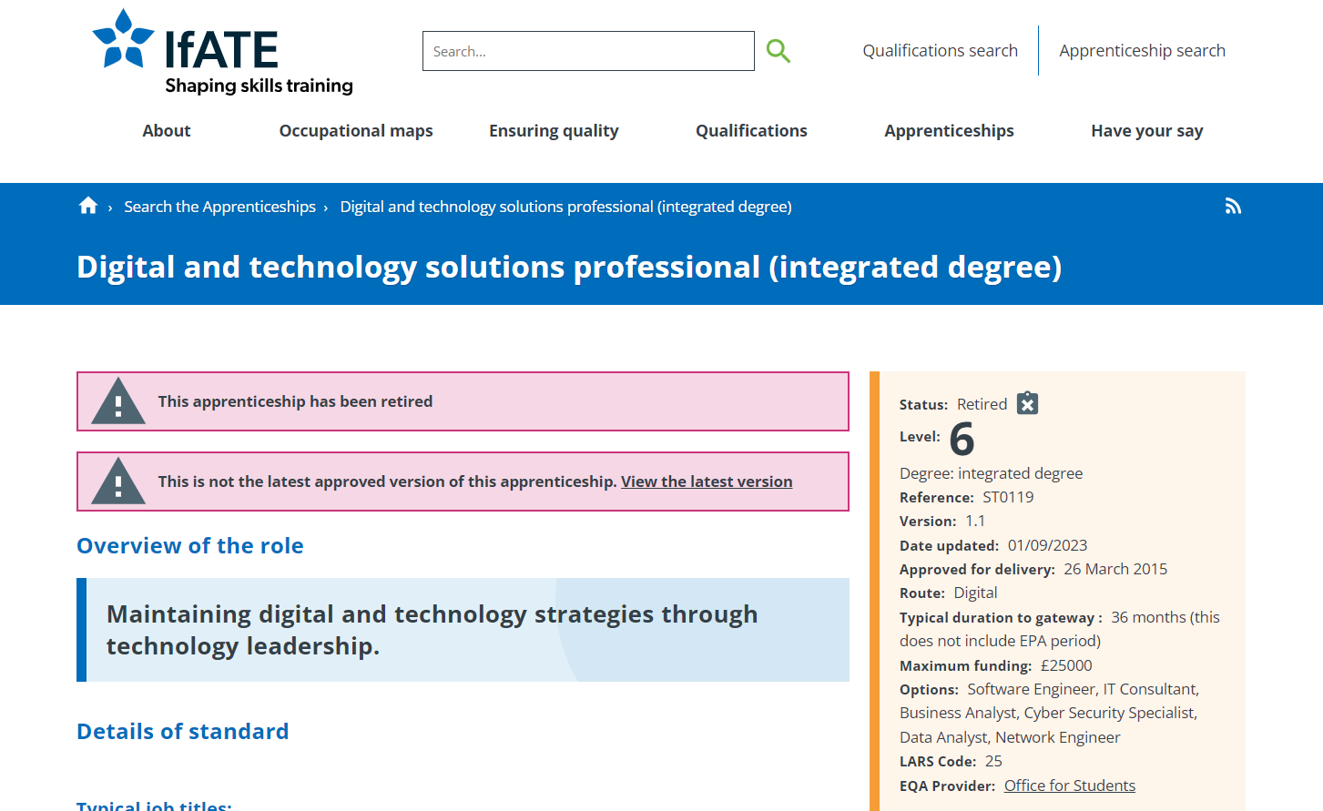
BSc Digital & Technology Solutions Professional (ST0119 - 2015 - version: 1.1)
INSTITUTE FOR APPRENTICESHIPS, 2015. Digital and technology solutions professional (integrated degree) [viewed 18 October 2024]. Available from: https://www.instituteforapprenticeships.org/apprenticeship-standards/digital-and-technology-solutions-professional-integrated-degree-v1-1

Slide 3
KSB
Knowledge, Skills & Behaviours

Slide 4
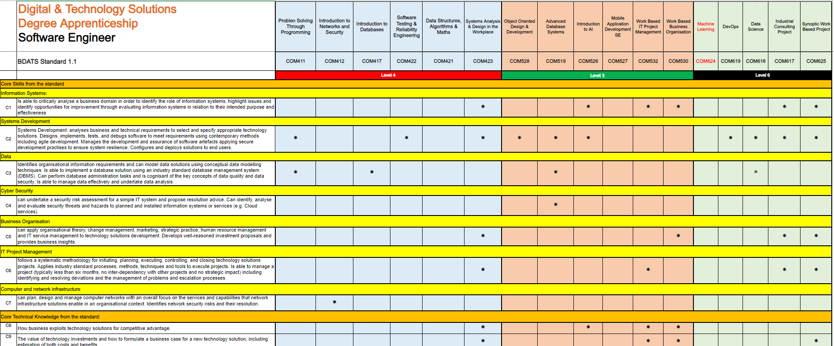
Knowledge, Skills & Behaviours (KSBs) Mapping

Slide 5
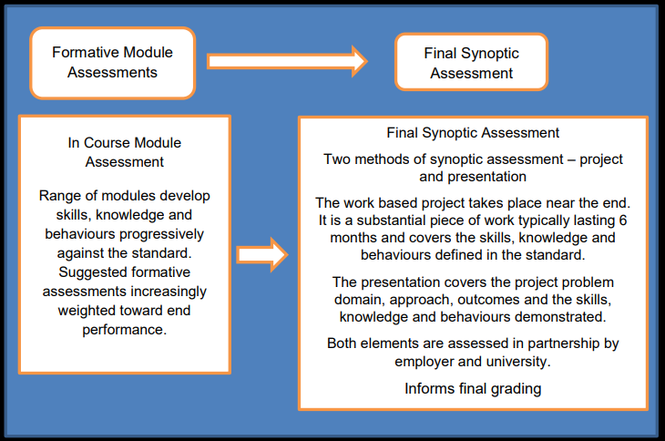
BSc Digital & Technology Solutions Professional (ST0119 - 2015 - version: 1.1)
INSTITUTE FOR APPRENTICESHIPS, 2015b. DIGITAL INDUSTRIES -ASSESSMENT PLAN DIGITAL & TECHNOLOGY SOLUTIONS PROFESSIONAL BSC (Hons) Digital & Technology Solutions. instituteforapprenticeships.org. Institute for Apprenticeships [viewed 18 October 2024]. Available from: https://www.instituteforapprenticeships.org/media/1073/digital_and_technology_solutions_professional.pdf

Slide 6
Overall Assessment Strategy
The assessment strategy for the Degree Apprenticeship includes a balanced mix of essays, reports, practical exercises, coursework, and tests. These are mapped to each module of the BSc Digital & Technology Solutions Degree Apprenticeship to assess the development of Knowledge, Skills, and Behaviours (KSBs). The End Point Assessment (EPA) consists of a Synoptic Project and Presentation.
INSTITUTE FOR APPRENTICESHIPS, 2015b. DIGITAL INDUSTRIES -ASSESSMENT PLAN DIGITAL & TECHNOLOGY SOLUTIONS PROFESSIONAL BSC (Hons) Digital & Technology Solutions. instituteforapprenticeships.org. Institute for Apprenticeships [viewed 18 October 2024]. Available from: https://www.instituteforapprenticeships.org/media/1073/digital_and_technology_solutions_professional.pdf

Slide 7
Portfolio Mapping

Slide 8
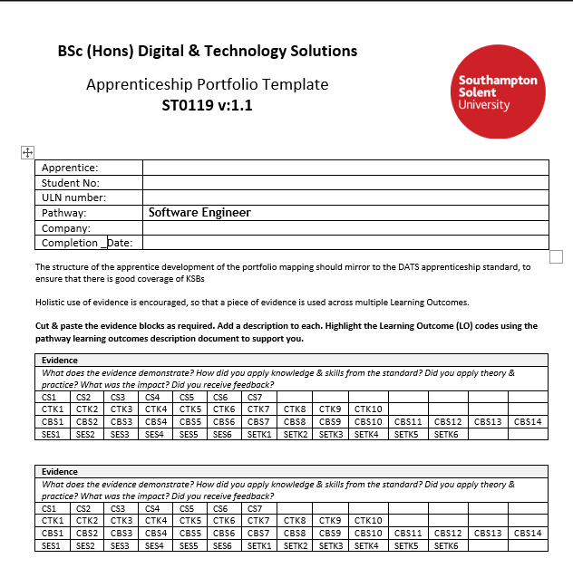

Slide 9
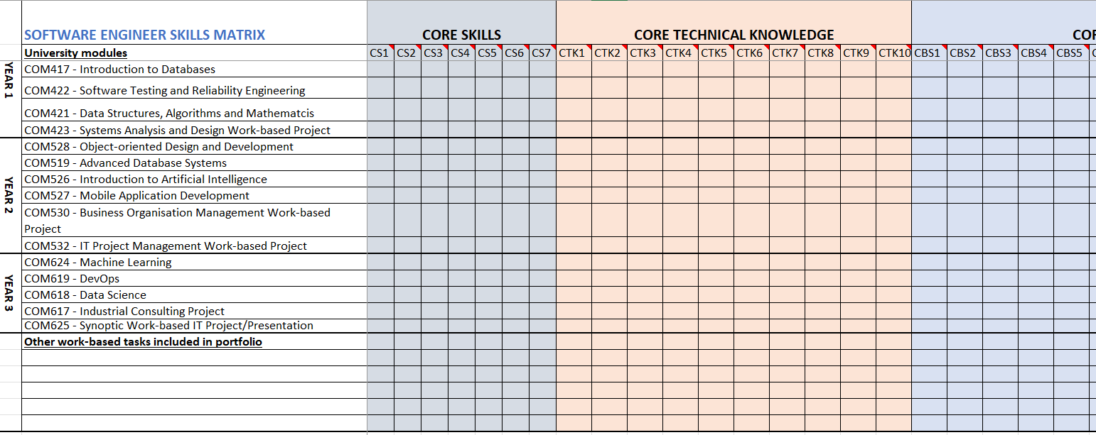

Slide 10
Synoptic Project

Slide 11

Project Selection
image: Ian Mationg

Slide 12

The final Synoptic Project is a substantial piece of work, typically taking around 6 months to undertake alongside the apprentices' normal duties to their employer and will include doing practical work and report writing.

Slide 13

The Project Aim The project should add value to your organisation, and it needs to hit the pathway learning outcomes (KSBs) that are in the apprenticeship standard.
Digital and technology solutions professional (integrated degree) / Institute for Apprenticeships and Technical Education

Slide 14

Project Sign Off The project topic must be discussed, agreed upon, and approved by the University, the Apprentice, and the company/manager before the project begins using the project outline form.
Digital and technology solutions professional (integrated degree) / Institute for Apprenticeships and Technical Education

Slide 15
AE1 – Report 1 - 10% (1500 words)
The initial phase of the project focuses on defining its scope and purpose, including any relevant business, ethical, legal, and professional considerations. This phase also involves reviewing existing literature and developing a project plan. Feasibility and requirements are assessed during this stage as well.
AE1

Slide 16
AE2 – Report 1 - 70%) (10,000 words)
The final project report should present a narrative of the project from inception to completion, aligned with the relevant Knowledge, Skills, and Behaviours (KSBs). It should outline the approaches taken, the rationale for their selection, and assess the project’s outputs in terms of their suitability for purpose. The report should also include conclusions, a critical review of the overall process, and recommendations for future development.
AE2

Slide 17

Final Report Structure
Title Page
Acknowledgements
Summary
Contents
List of Figures
Project Specification/Requirements
Methodology/Evaluation
Professional, Legal and Ethical issues
Project Management
Design, implementation
Testing & Results
Conclusions
Recommendations for further Work and/or discussion
References List
Appendices

Slide 18
AE3 – Demo/Presentation - 20% (25-30mins)
To support your Project Report, you will need to give a presentation/demonstration of your project.
AE3

Slide 19
Gateway

Slide 20
BSc Digital & Technology Solutions Professional (ST0119 - 2015 - version: 1.1)
On Programme Completion
Gateway EPA Ready Meeting & Sign off
Synoptic Project Outline
Gateway
Synoptic Project COM625
Completed Synoptic Project & Report
Employer Reference
KSB Portfolio Mapping/Matrix
Completed Off-the-Job Tracker
End Point Assessment (EPA)

Slide 21

Upon completion of the on-programme off-the-job training, a Gateway meeting will be arranged to ensure that the apprentice has completed and passed all modules and is ready to progress to the End Point Assessment (EPA).
This meeting will also verify that all required documents, including the off-the-job training tracker, portfolio mapping and employer reference, have been completed.

Slide 22
EPA
End Point Assessment

Slide 23


The Synoptic work-based project takes place near the end of the apprenticeship. It is a substantial piece of work and covers the skills, knowledge and behaviours defined in the standard.

Slide 24
The End Point Assessment (EPA) integrates the project outcomes and presentation into the overall Synoptic Project Assessment.
Two methods of assessment:
Synoptic Work based Project Practical & reporting
Presentation 1 hour (30mins plus Q&A) to the EPA Assessor, Tutor & Employer
INSTITUTE FOR APPRENTICESHIPS, 2015b. DIGITAL INDUSTRIES -ASSESSMENT PLAN DIGITAL & TECHNOLOGY SOLUTIONS PROFESSIONAL BSC (Hons) Digital & Technology Solutions. instituteforapprenticeships.org. Institute for Apprenticeships [viewed 18 October 2024]. Available from: https://www.instituteforapprenticeships.org/media/1073/digital_and_technology_solutions_professional.pdf

Slide 25

EPA Presentation - 1 hour

Slide 26

"The presentation is a structured discussion between the apprentice and their university lecturer/s and employer, focusing on the outcomes of the synoptic project. It covers both what the apprentice has done, the standard of their work, and how they have done it."
EPA Assessor
Tutor
Employer
The Presentation (P.7 2.2.3)
INSTITUTE FOR APPRENTICESHIPS.ORG, 2015. DIGITAL INDUSTRIES -ASSESSMENT PLAN DIGITAL & TECHNOLOGY SOLUTIONS PROFESSIONAL BSC (Hons) Digital & Technology Solutions [viewed 14 February 2025]. Available from: https://www.instituteforapprenticeships.org/media/1073/digital_and_technology_solutions_professional.pdf

Slide 27

EPA Assessor The EPA assessor will already have access to the Apprentice’s Synoptic Project Report. They will need to formulate questions about the project, either using the provided question bank or by creating their own.
The Assessor will ask between 4 and 6 questions. They can also ask follow-up questions, provided that all questioning and discussion are completed within the allocated time frame

Slide 28
Employer Reference The assessment of the Synoptic Project should include the employer’s evaluation against the common criteria. This will be in Employer's Reference, in Appendix C of the Synoptic Report This will be discussed when working out the final grade and feedback in the assessment meeting following the EPA presentation

Slide 29
Support Tutor Assessment Support tutor will also evaluate and assess the Apprentice Synoptic Report and Presentation and will have available appropriate documentation to discuss and help finalise final grade at the EPA assessment meeting following on from the EPA Presentation.
This will fill fulfil the university’s regulations on having two graders on a 40-Credit module assessment

Slide 30
The EPA Presentation serves to demonstrate how the apprentice has approached and achieved the project. It aims to explore the apprentices' process including problem solving and overall work, and must:
Review the project's aims and results.
Demonstrate the standard of work.
Explain the approach and address issues.
Clarify any questions from university/employer.
Confirm interpersonal and behavioural skills.
Be assessed as part of the overall project assessment and inform the degree award.

Slide 31

Project Presentation Format
Will take place online & be recorded for moderation
A conflict-of-interest form must be completed to confirm that the Apprentice and Assessor do not know each other
The Apprentice will present for 25-30 minutes, followed by a Q&A session within a 1-hour time slot
The Apprentice will leave meeting
Assessor, Tutor and Employer collaboratively finalise grade and feedback (Report & Feedback)
EPA Presentation - 1 hour

Slide 32

Assessment & Grading

Slide 33
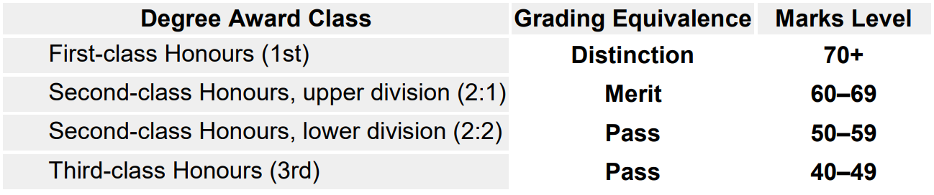
Assessment and Grading
The Honours degree award and classification is based on a weighted average mark of the assessed work the apprentice has completed. The Synoptic Project (40 credits) contributes greatly to the final year marks. Apprentices will be graded using Honours degree classifications for English universities. The national degree award outcomes are shown below with apprenticeship grading equivalence. These typically are as follows:

Slide 34

Grade Criteria & Calculation

Slide 35


Slide 36
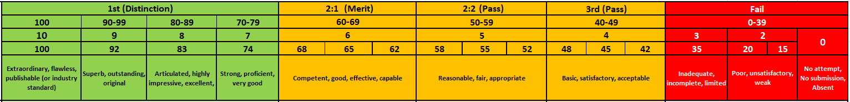
Numeric Grade Marks

Slide 37
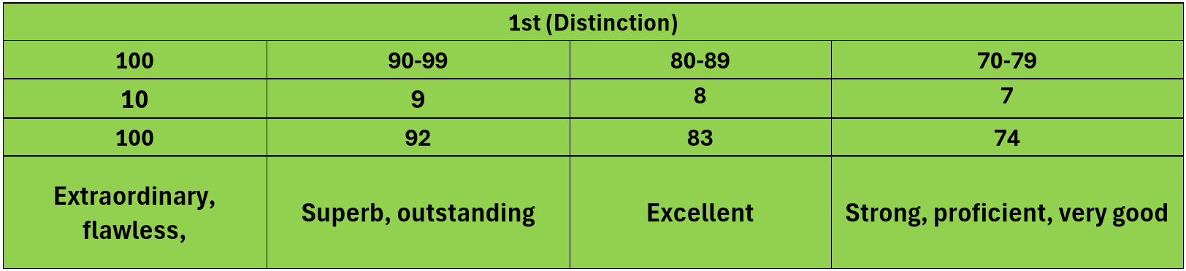
Extraordinary 100%: This grade is for work that is truly exceptional in every way. The project demonstrates groundbreaking innovation and has a significant impact on the organisation. The report is meticulously detailed, and the presentation is highly engaging and professional.

Slide 38
Outstanding 92%: This grade is for work that is significantly above average. The project shows a high level of creativity and effectiveness. The report is thorough and well-organised, and the presentation is clear and confident.

Slide 39
Excellent 83%: This grade indicates very high-quality work. The project is well-executed and meets all the objectives effectively. The report is comprehensive and well-written, and the presentation is polished and informative.

Slide 40
Excellent 83%: This grade indicates very high-quality work. The project is well-executed and meets all the objectives effectively. The report is comprehensive and well-written, and the presentation is polished and informative.

Slide 41
Strong/Very Good 74%: This grade is for work that is above average. The project is solid and achieves its goals. The report is detailed and clear, and the presentation is well-prepared and delivered.

Slide 42
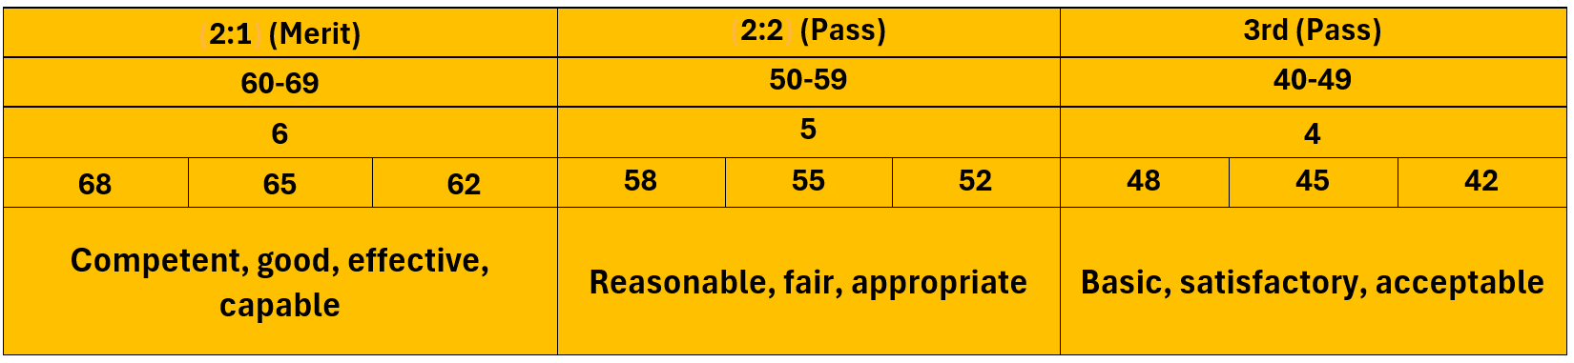
Competent, good, effective, capable 60-69%: This grade is for work that meets the basic requirements. The project is adequately executed and achieves its main objectives. The report is clear and covers the necessary points, and the presentation is satisfactory.

Slide 43
Reasonable, fair, appropriate 50-59%: This grade is for work that is acceptable but has some shortcomings. The project meets most objectives but lacks depth or thoroughness. The report is adequate but may be missing some details, and the presentation is clear but not particularly engaging..

Slide 44
Basic, satisfactory, acceptable 40-49%: This grade is for work that meets the minimum requirements. The project is completed but lacks depth and impact. The report covers the basics but is not detailed, and the presentation is clear but lacks enthusiasm.

Slide 45
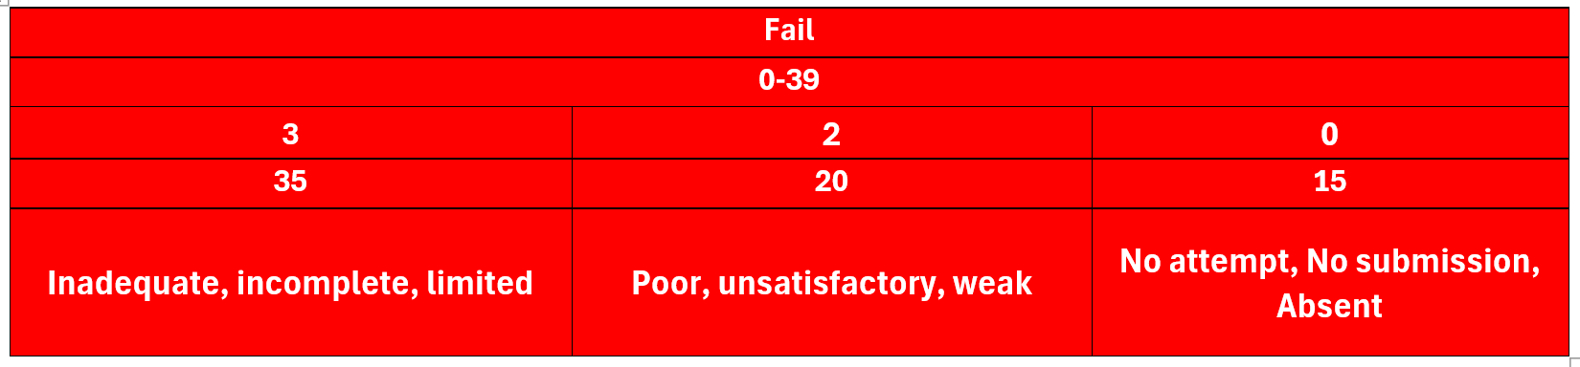
Inadequate, incomplete, limited 30-39: This grade is for work that does not meet the required standards. The project fails to achieve its main objectives. The report is incomplete or poorly organised, and the presentation is unclear or unprofessional.

Slide 46
Poor, unsatisfactory, weak 20-39%: This grade is for work that is significantly below the required standards. The project is poorly executed and has little to no impact. The report is very incomplete or poorly written, and the presentation is unclear and unengaging.

Slide 47
Inadequate, incomplete, limited 30-39: This grade is for work that does not meet the required standards. The project fails to achieve its main objectives. The report is incomplete or poorly organised, and the presentation is unclear or unprofessional.

Slide 48

Before your EPA presentation assessment, you will receive the following:
The Apprentice’s 10k synoptic project report
Slide Deck for Synoptic Project Presentation
The portfolio KSB mapping matrix (for all learning)
Supporting guidance and Grade Mark Rubrics.

Slide 49
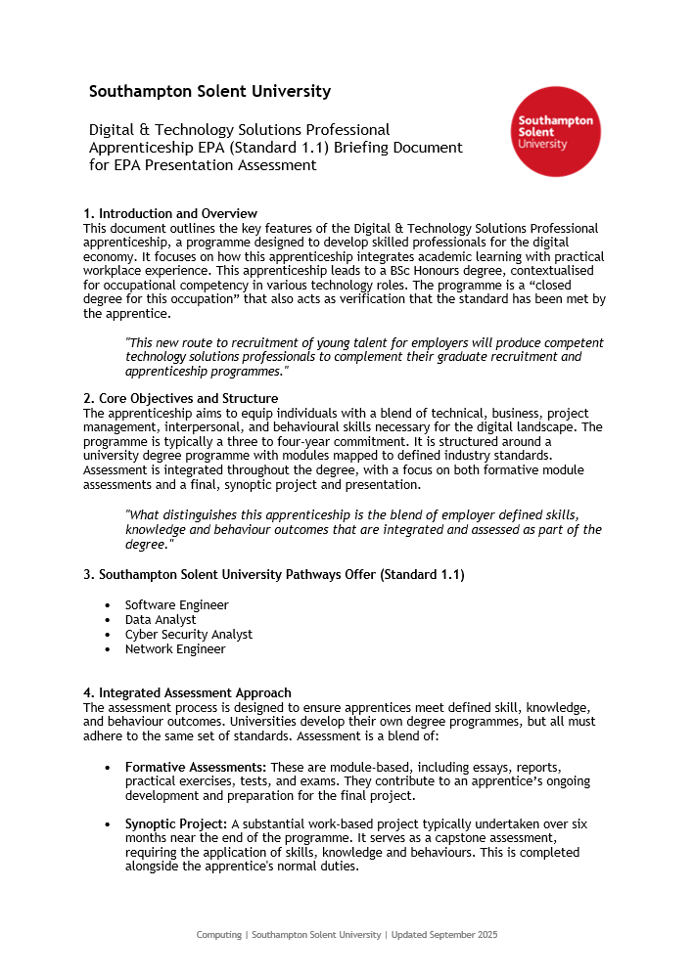


Slide 50
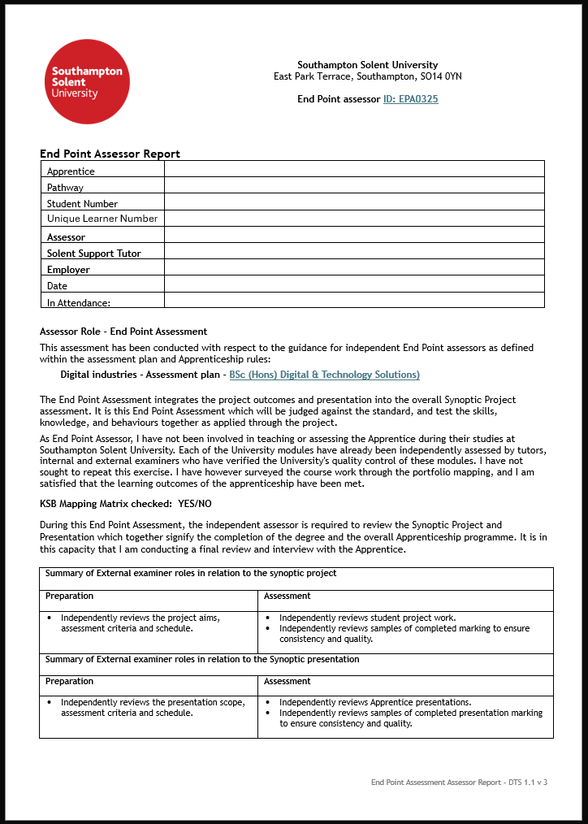
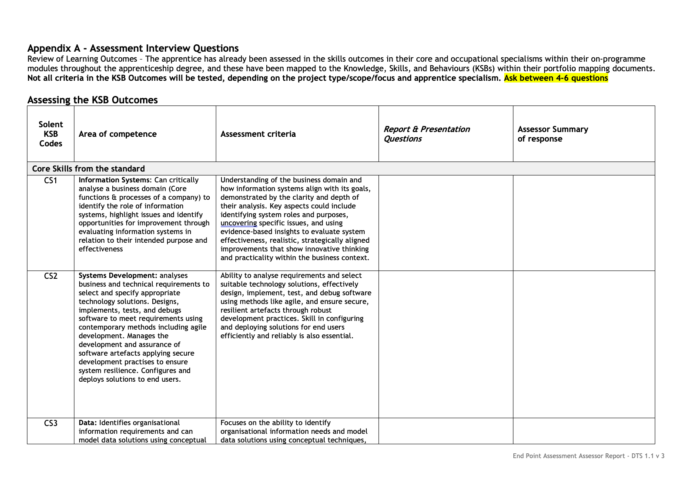

Slide 51
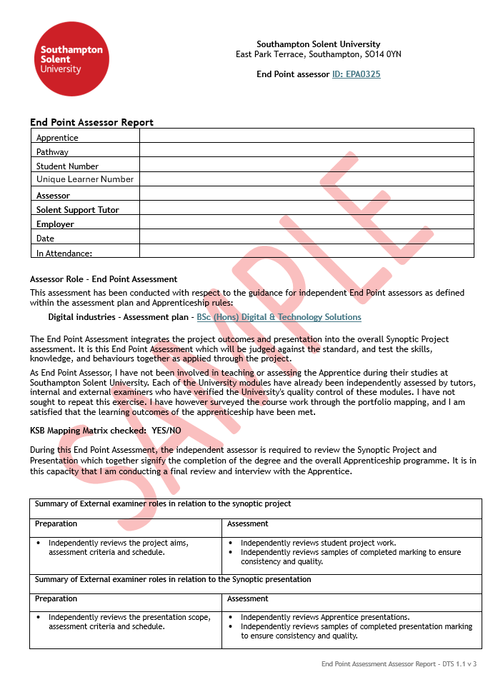
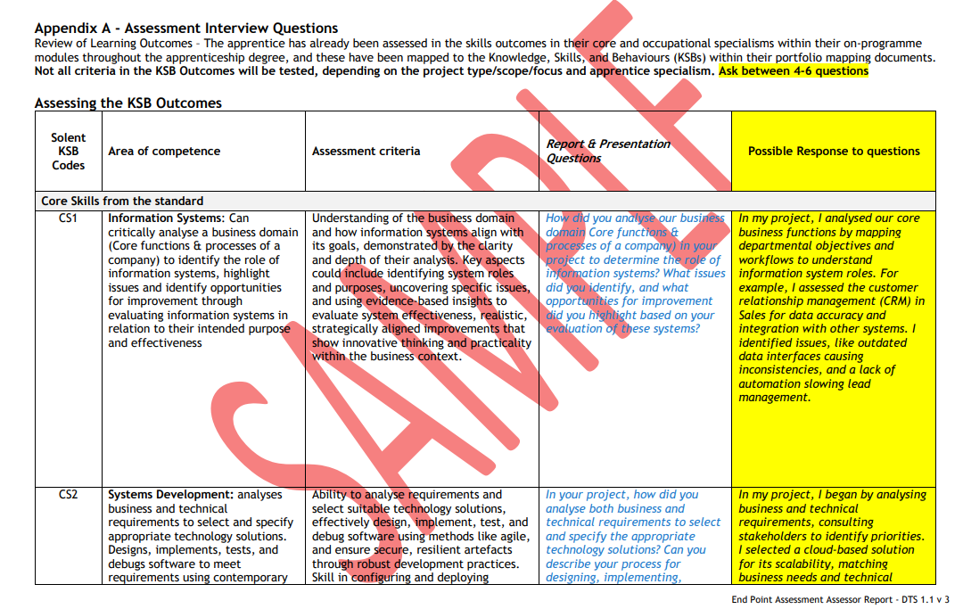

Slide 52
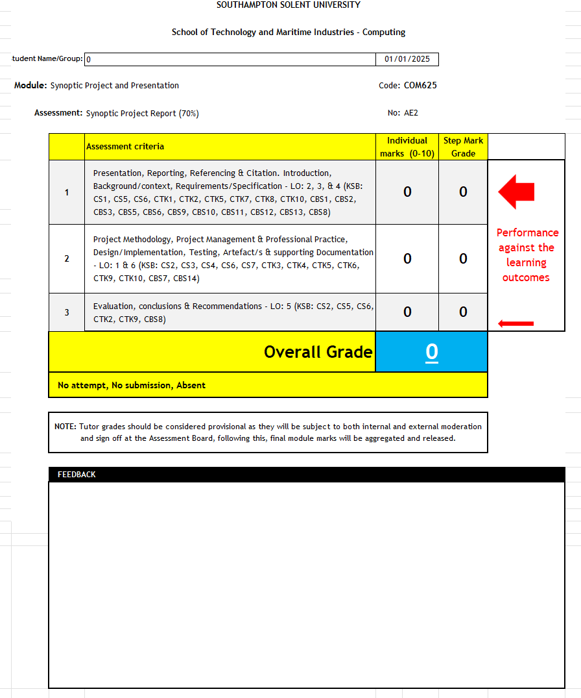
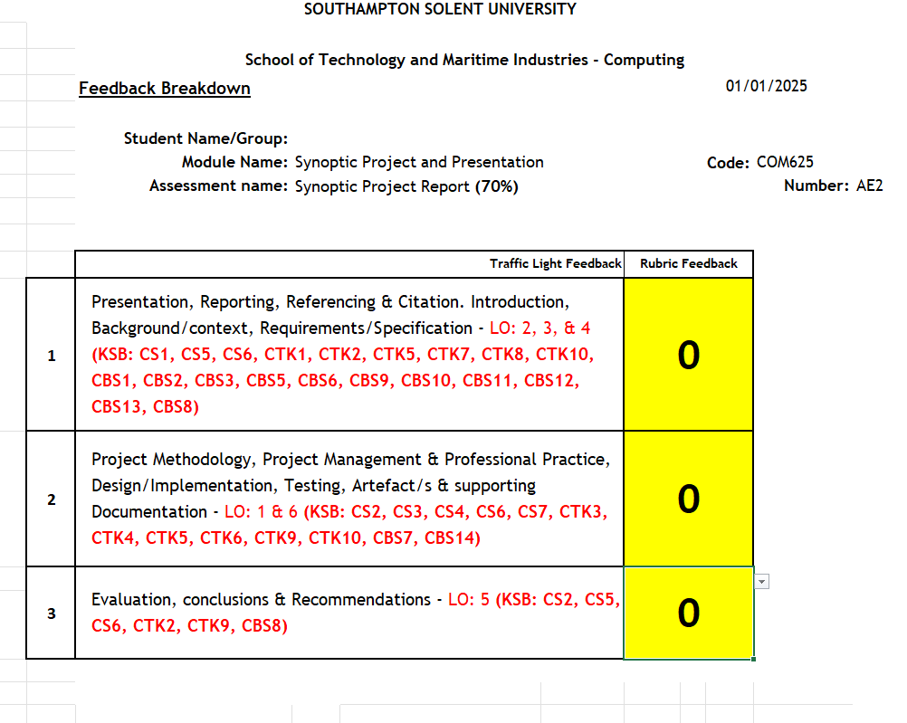
AE2

Slide 53
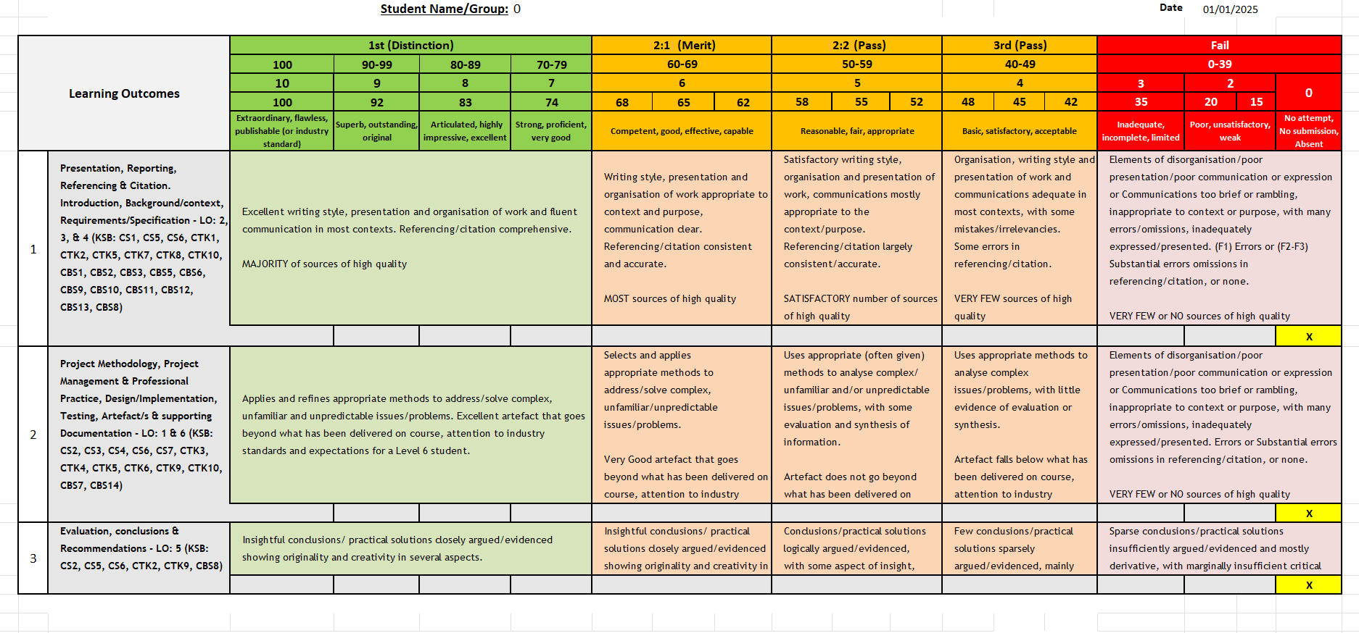
AE2

Slide 54
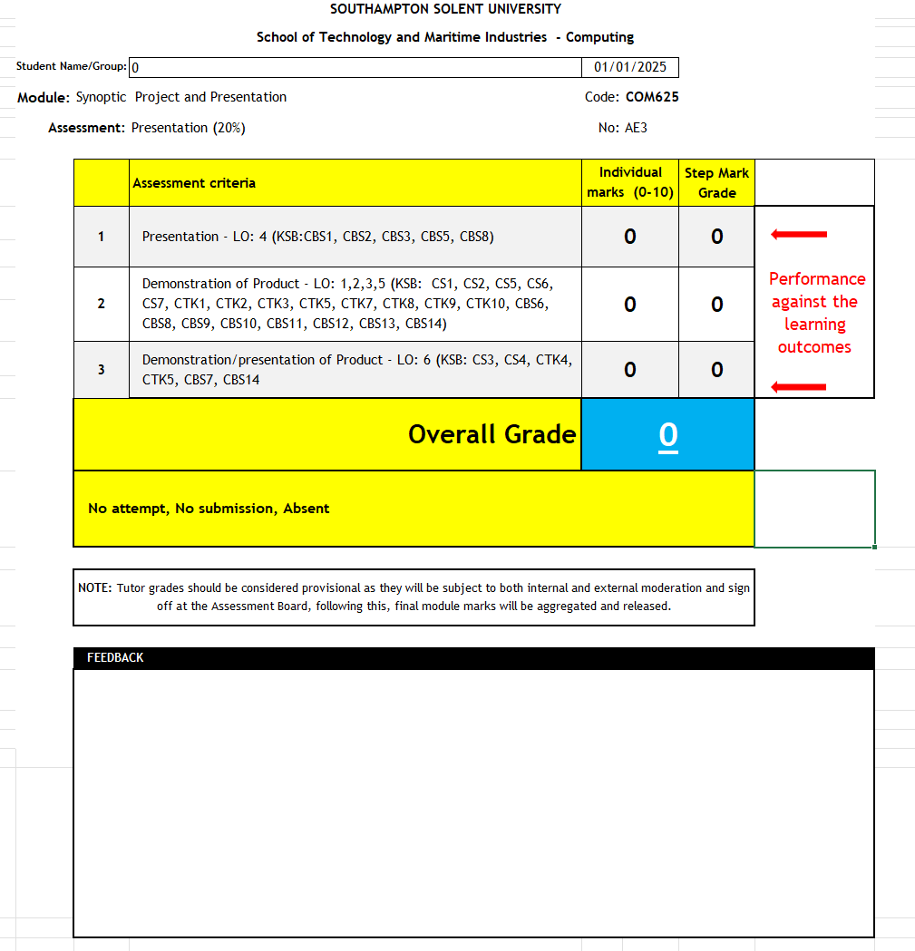
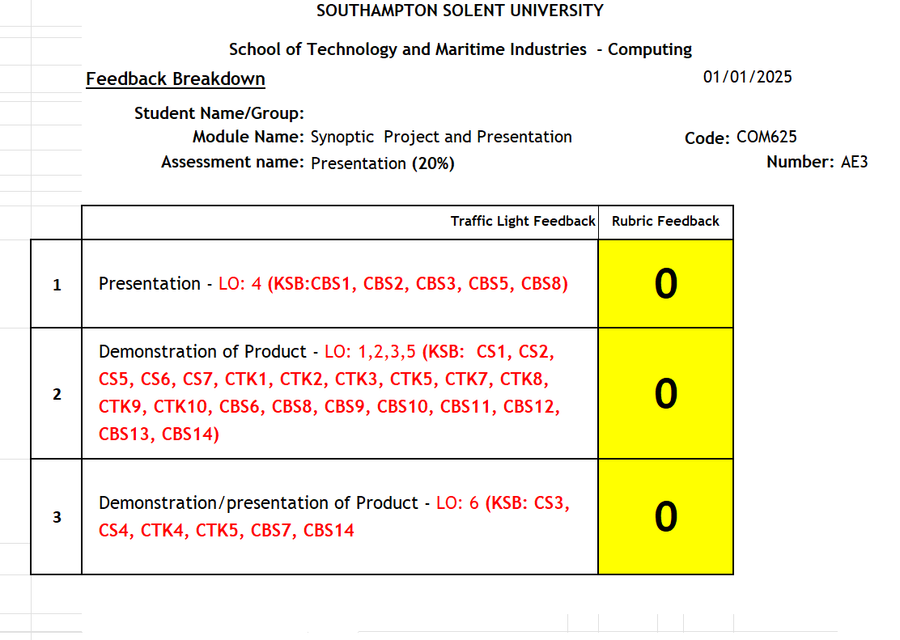
AE3

Slide 55
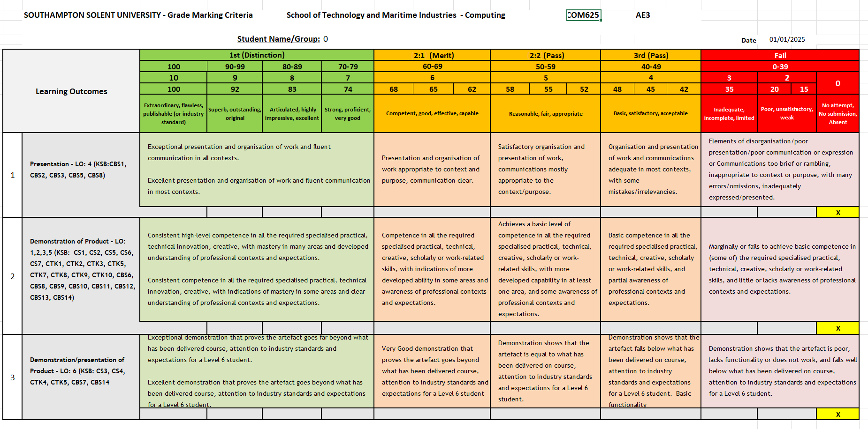
AE3

Slide 56
Thank You

